Slide 1




NEXT GEN EMPLOYABILITY PROGRAM
Creating a future-ready workforce
Team Members
College Name
Student Name :Shaleny.T.S
Student ID :au960221104107
Arunachala College Of Engineering for Women

Slide 2

CAPSTONE PROJECT SHOWCASE
Project Title
Car Rentals Application with Django Framework
Abstract | Problem Statement | Project Overview | Proposed Solution | Technology Used | Modelling & Results | Conclusion

Slide 3
Abstract
Our project involves developing a dynamic car rental website utilizing Django, a powerful Python web framework. Through this platform, users will enjoy a seamless experience in browsing, selecting, and booking rental vehicles. We prioritize security by implementing robust authentication measures and secure payment processing to safeguard user data. The website's responsive design ensures optimal usability across various devices, enhancing accessibility for all users. Furthermore, administrators will benefit from Django's built-in admin interface, facilitating efficient backend management tasks such as inventory tracking and booking management. Our goal is to revolutionize the car rental industry by delivering a user-centric platform that prioritizes convenience, reliability, and security for travelers worldwide.
Source :

Slide 4
Problem Statement
The current landscape of car rental platforms suffers from fragmented user experiences and security vulnerabilities, both for customers and administrators. Users often encounter usability issues and concerns about the security of their personal data during transactions, while administrators struggle with inefficient backend management processes. Our project aims to tackle these challenges by developing a comprehensive car rental website using Django. Through this platform, users will benefit from a seamless and intuitive interface for vehicle selection, booking management, and secure payment processing. Meanwhile, administrators will have access to robust backend management tools to efficiently track inventory, manage bookings, and ensure platform security. By addressing usability and security concerns, our goal is to provide a unified and trustworthy solution for both customers and rental businesses, ultimately enhancing the overall car rental experience.
Source :

Slide 5
Project Overview
Our project involves developing a comprehensive car rental website using the Django framework. The website aims to provide users with a seamless platform for renting vehicles for various purposes, from daily commutes to long-distance trips.
Key Features:
User Registration and Authentication: Users can create accounts and log in securely to access the website's features.
2.Car Listings: A wide range of vehicles will be listed with detailed descriptions, including make, model, year, pricing, and availability status.
3.Booking System: Users can select their desired vehicle, choose rental dates, and make reservations with ease.
Source :

Slide 6
Proposed Solution
.
Our solution entails developing a user-friendly car rental website using Django, a robust Python web framework. Key features include intuitive vehicle browsing, secure booking and payment processing, responsive design for cross-device compatibility, and efficient backend management tools. By prioritizing usability, security, and convenience, our solution aims to enhance the overall car rental experience for both users and administrators.
Source :

Slide 7
Effortless Booking:
Browse and select your ideal vehicle quickly and easily with our intuitive platform.
Secure Reservations:
Enjoy peace of mind with our streamlined booking system, ensuring a secure and hassle-free experience.
Mobile-Friendly Access:
Make reservations on-the-go from any device with our mobile-friendly interface.
Quality Assurance:
Drive with confidence knowing that all vehicles undergo rigorous maintenance and safety checks.
24/7 Support:
Our dedicated customer support team is available around the clock to assist you whenever you need.
Source :

Slide 8
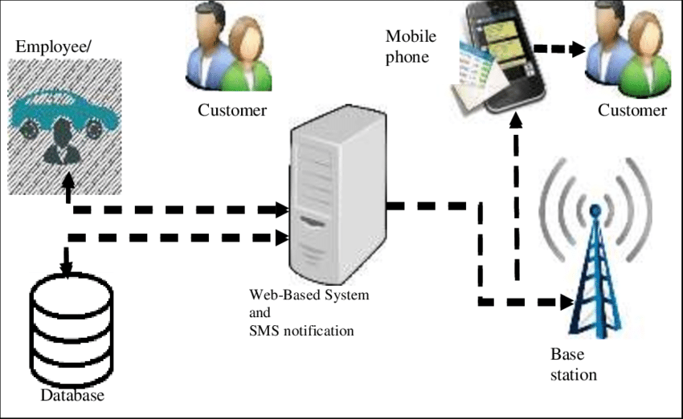
Car rental system architecture:
Source :

Slide 9


Technology Used
Front-end
Back-end
Source :

Slide 10
Modelling & Results
Modelling:
Cars: Create a model with fields for make, model, year, color, mileage, price per day, and availability status (boolean).
Reservations: Design a model with foreign keys to the User and Car models, along with fields for start date, end date, total price, and any additional options.
Results:
Available Cars: Query the database for cars where the availability status is set to True, and display them on the website.
User's Reservations: Retrieve reservations associated with the currently logged-in user from the database and present them in a user-friendly format.
Total Revenue: Calculate the total revenue by summing up the total price of all reservations made through the website. This can be done using aggregation functions provided by Django ORM.
Source :

Slide 11
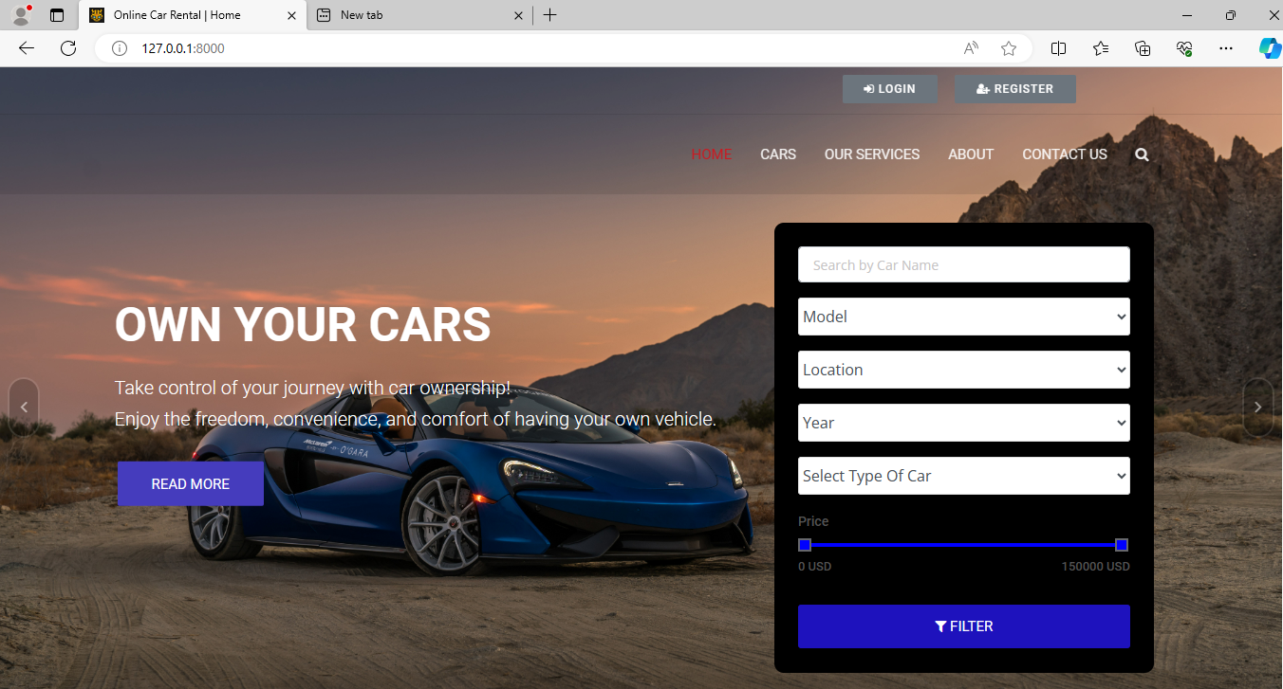
Homepage

Slide 12
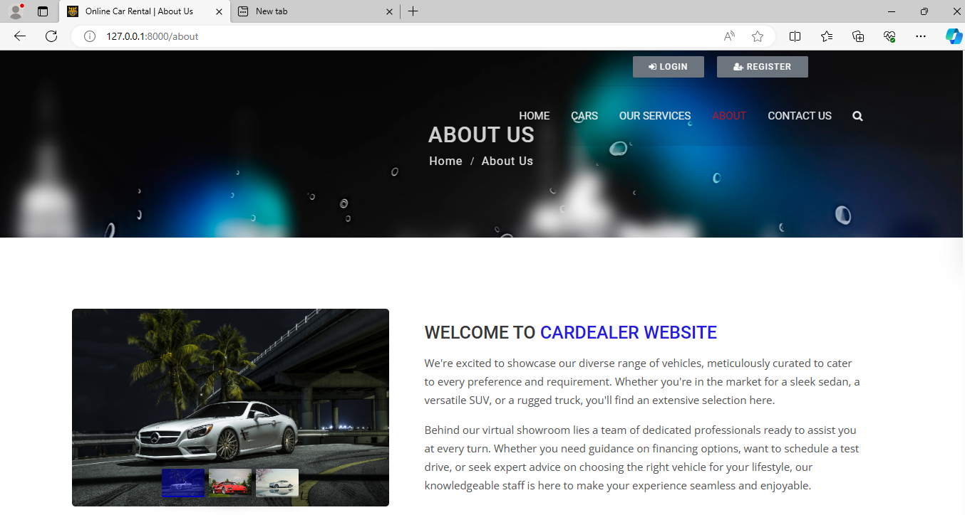
About-Us-Page

Slide 13
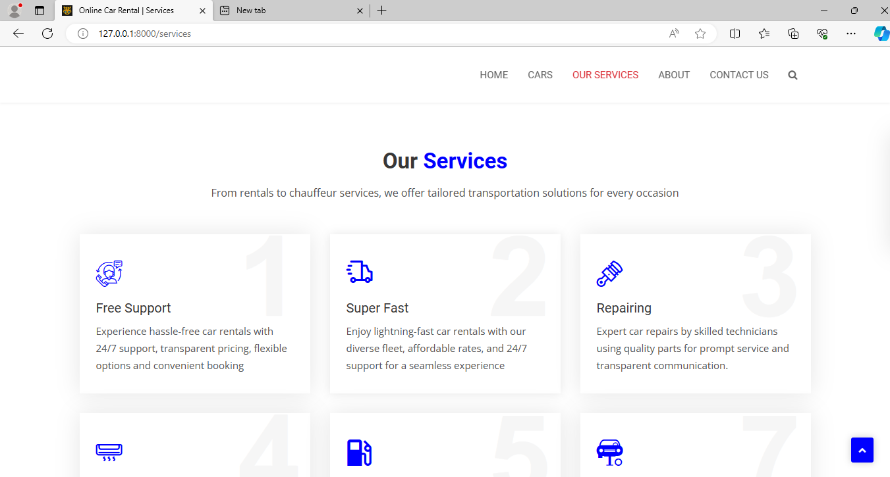
Service-Page

Slide 14
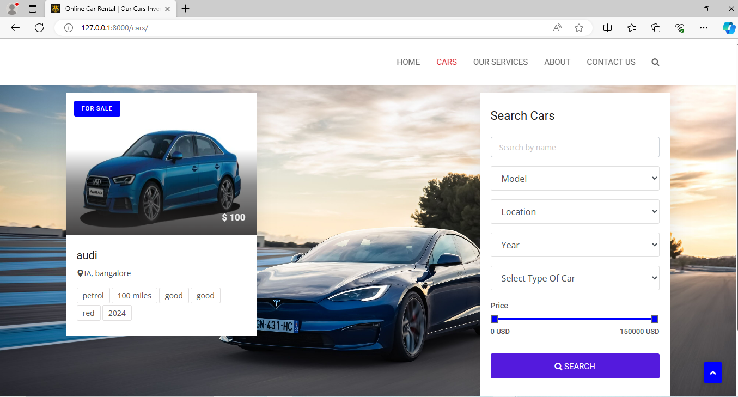
Cars-Page

Slide 15
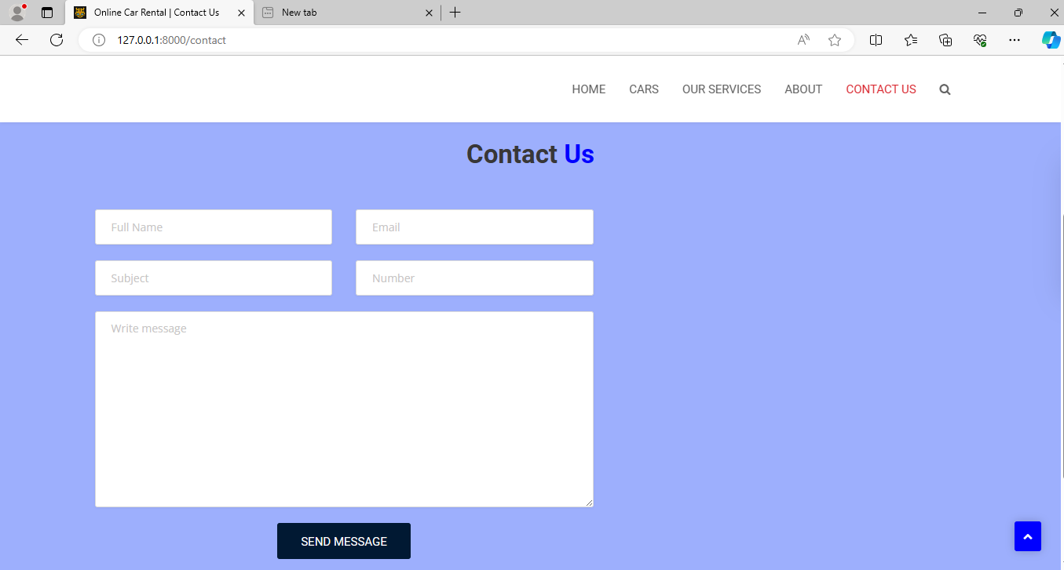
Contact Us-Page

Slide 16
Future Enhancements:
Keyless Entry: Implement keyless entry systems for rental vehicles, enhancing security and streamlining the check-in process.
Dynamic Pricing: Introduce dynamic pricing algorithms to adjust rental rates based on factors like demand, availability, and market trends.
Social Sharing: Allow users to share their rental experiences on social media directly from the website, increasing brand visibility and engagement.
Instant Booking Confirmation: Offer instant booking confirmation to users, providing immediate peace of mind and reducing friction in the booking process.
Smartphone App Integration: Integrate the rental service with popular smartphone apps for navigation, parking, and travel planning, enhancing the overall user experience.
Loyalty Program: Launch a loyalty program to reward frequent renters with discounts, upgrades, or exclusive perks, fostering customer loyalty and retention.
Vehicle Customization Options: Allow users to customize their rental vehicle with optional features or accessories, such as car seats, roof racks, or entertainment systems.
Data Analytics Dashboard: Develop a data analytics dashboard for administrators to track key performance metrics, identify trends, and make data-driven decisions.

Slide 17
Conclusion
In conclusion, the car rental website stands at the brink of exciting opportunities for growth and enhancement. By implementing features like keyless entry, dynamic pricing, and social sharing, it can elevate user experience and remain competitive in the market. Initiatives such as loyalty programs and instant booking confirmation will bolster customer satisfaction and loyalty. With a focus on innovation and customer-centricity, the website is well-positioned to thrive and lead the way in the ever-evolving car rental industry.
Source :

Slide 18
Thank You!
Notes:
Thank You !!

